Slide 1
Support Vector Machine
Il-Chul Moon Dept. of Industrial and Systems Engineering KAIST
icmoon@kaist.ac.kr

Slide 2
Weekly Objectives
Learn the support vector machine classifier
Understand the maximum margin idea of the SVM
Understand the formulation of the optimization problem
Learn the soft-margin and penalization
Know how to add the penalization term
Understand the difference between the log-loss and the hinge-loss
Learn the kernel trick
Understand the primal problem and the dual problem of SVM
Know the types of kernels
Understand how to apply the kernel trick to SVM and logistic regression

Slide 3
Support vector machine

Slide 4
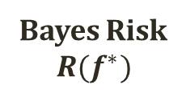
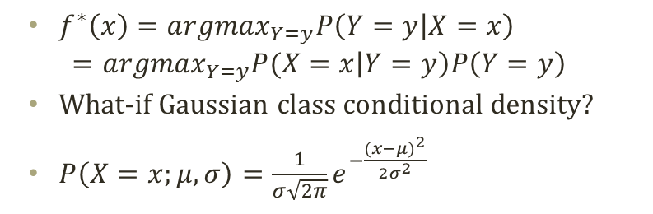
Detour: Decision Boundary
P(Y=y|X)
P(Y=y|X)
1
Bayes Risk
$$R(f^{∗})$$
0
X
Classify as y
Classify as y
Why are shapes different?
$f^{∗}\left(x\right)={argmax}_{Y=y}P\left(Y=y | X=x\right)$
$$={argmax}_{Y=y}P(X=x\left|Y=y\right)P\left(Y=y\right)$$
What-if Gaussian class conditional density?
$P\left(X=x;μ,σ\right)=\frac{1}{σ\sqrt{2π}}e^{−\frac{{(x−μ)}^{2}}{2σ^{2}}}$
P(X=x|Y=y)P(Y=y)
P(X=x|Y=y)P(Y=y)
X

Slide 5
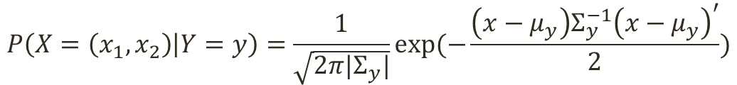
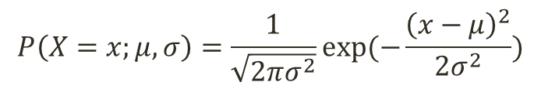
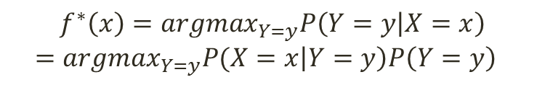
Detour: Decision Boundary in Two Dimension
Decision Boundary in Two Dimensions
$$f^{∗}\left(x\right)={argmax}_{Y=y}P\left(Y=y | X=x\right)$$
$$={argmax}_{Y=y}P(X=x\left|Y=y\right)P\left(Y=y\right)$$
P(X=x|Y=y)P(Y=y)
Two multivariate normal distribution for the class conditional densities
Decision boundary
A linear line
Linear decision boundary
Any problem in the real world applications?
Observing the combination of x₁ and x₂
P(X=x|Y=y)P(Y=y)
$$P\left(X=x;μ,σ\right)=\frac{1}{\sqrt{2πσ^{2}}}exp⁡(−\frac{{\left(x−μ\right)}^{2}}{2σ^{2}})$$
$$P\left(X=\left(x_{1},x_{2}\right) | Y=y\right)=\frac{1}{\sqrt{2π|Σ_{y}|}}exp⁡(−\frac{\left(x−μ_{y}\right)Σ_{y}^{−1}{\left(x−μ_{y}\right)}^{′}}{2})$$

Slide 6
Decision Boundary without Prob.
Which is a better decision boundary?
Without considering the probability distribution?
Which points are at the front line?

Slide 7

Decision Boundary with Margin
Decision boundary with maximum margin
Between the points close to the boundary
How many points?
Decision boundary line
$w∙x+b=0$
Positive case
$w∙x+b>0$
Negative case
$w∙x+b<0$
Confidence level
$(w∙x_{j}+b)y_{j}$
Margin?
Perpendicular distance from the closest point to the decision boundary
How many parameters?

Slide 8
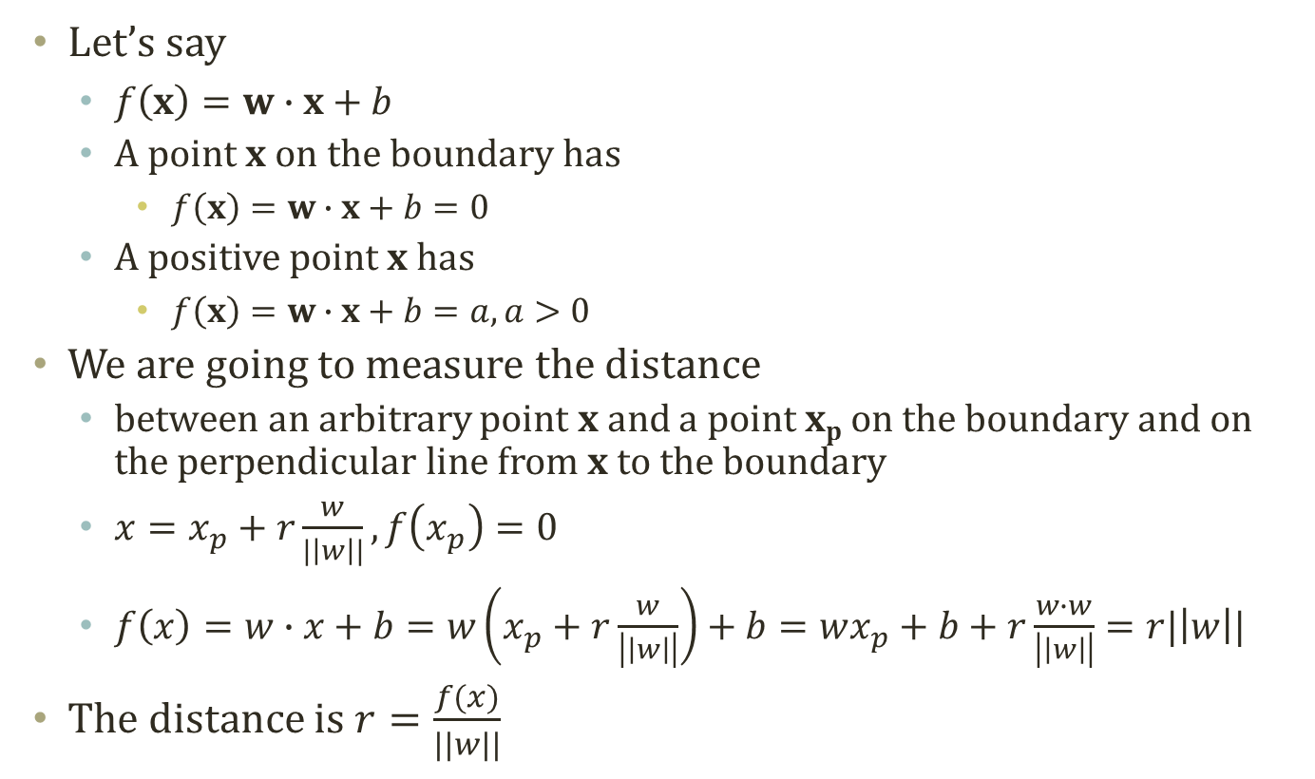

Margin Distance
(3,3)
x_{p}
w=(1,-1)
(2,2)
Let’s say
$f\left(x\right)=w∙x+b$
A point x on the boundary has
$f\left(x\right)=w∙x+b=0$
A positive point x has
$f\left(x\right)=w∙x+b=a, a>0$
We are going to measure the distance
between an arbitrary point x and a point x_{p} on the boundary and on the perpendicular line from x to the boundary
$x=x_{p}+r\frac{w}{|\left|w\right||}, f\left(x_{p}\right)=0$
$f\left(x\right)=w∙x+b=w\left(x_{p}+r\frac{w}{\left|\left|w\right|\right|}\right)+b=wx_{p}+b+r\frac{w∙w}{\left|\left|w\right|\right|}=r|\left|w\right||$
The distance is $r=\frac{f(x)}{|\left|w\right||}$
$$x_{2}=x_{1}−1.5 \\ →x_{1}−x_{2}−1.5=0$$
(3,0)
x

Slide 9

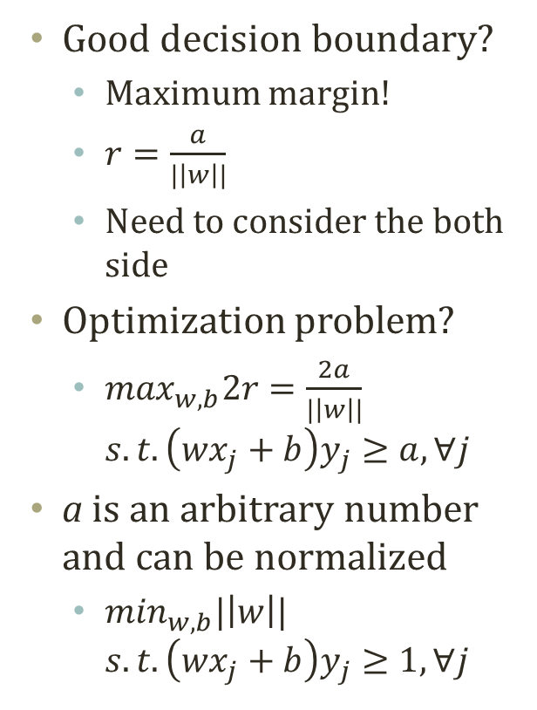



Maximizing the Margin
Good decision boundary?
Maximum margin!
$r=\frac{a}{|\left|w\right||}$
Need to consider the both side
Optimization problem?
$\max_{w,b}2r=\frac{2a}{|\left|w\right||}$ $s.t. \left(wx_{j}+b\right)y_{j}≥a,∀j$
a is an arbitrary number and can be normalized
$\min_{w,b}|\left|w\right||$ $s.t. \left(wx_{j}+b\right)y_{j}≥1,∀j$
$$f\left(x\right)=w∙x+b=−a$$
$$r=\frac{f(x)}{|\left|w\right||}$$
$f\left(x\right)=w∙x+b$=0
$$f\left(x\right)=w∙x+b=a$$
This becomes a quadratic optimization problem. Why?

Slide 10
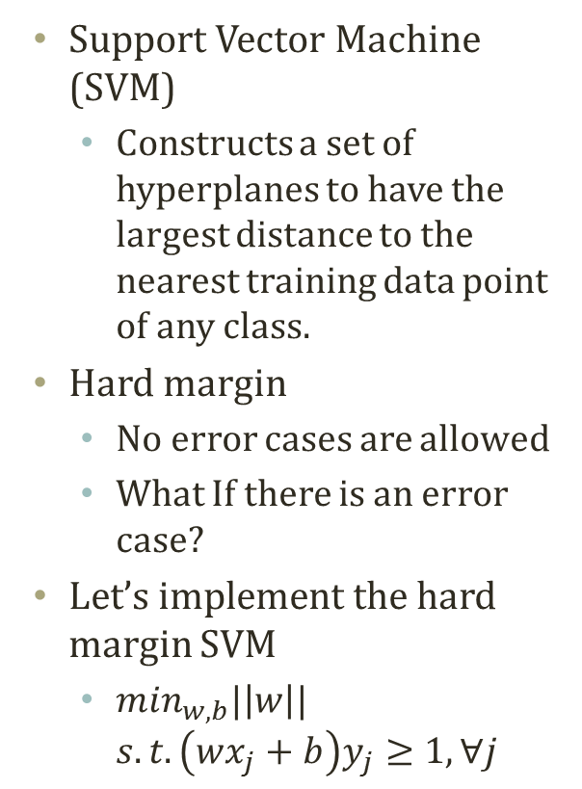
Support Vector Machine with Hard Margin
Support Vector Machine (SVM)
Constructs a set of hyperplanes to have the largest distance to the nearest training data point of any class.
Hard margin
No error cases are allowed
What If there is an error case?
Let’s implement the hard margin SVM
$\min_{w,b}|\left|w\right||$ $s.t. \left(wx_{j}+b\right)y_{j}≥1,∀j$
New Decision Boundary!
Difficult Problem!!!

Slide 11
Soft margin

Slide 12
“Error” Cases in SVM
Non-linear decision boundary
Data points that are
Impossible to classify with a linear decision boundary
So called, “error” cases…
How to manage these?
Option 1
Make decision boundary more complex
Go to non-linear
Any problem?
Option 2
Admit there will be an “error”
Represent the error in our problem formulation.
Try to reduce the error as well.
Any problem?
Allow some error in observations
No way to represent this with linear decision boundary

Slide 13
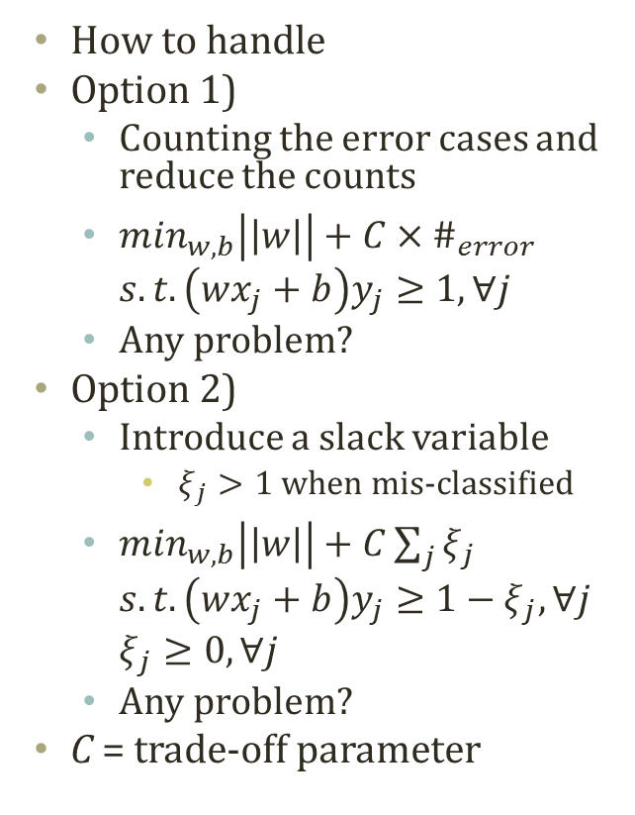

“Error” Handling in SVM
How to handle
Option 1)
Counting the error cases and reduce the counts
$\min_{w,b}\left|\left|w\right|\right|+C×\#_{error}$ $s.t. \left(wx_{j}+b\right)y_{j}≥1,∀j$
Any problem?
Option 2)
Introduce a slack variable
$ξ_{j}>1$ when mis-classified
$\min_{w,b}\left|\left|w\right|\right|+C\sum_{j}{ξ_{j}}$ $s.t. \left(wx_{j}+b\right)y_{j}≥1−ξ_{j},∀j$ $ξ_{j}≥0,∀j$
Any problem?
C = trade-off parameter
Size of Loss
Hinge Loss
0-1 Loss
-1
0
1
$$\left(wx_{j}+b\right)y_{j}$$

Slide 14



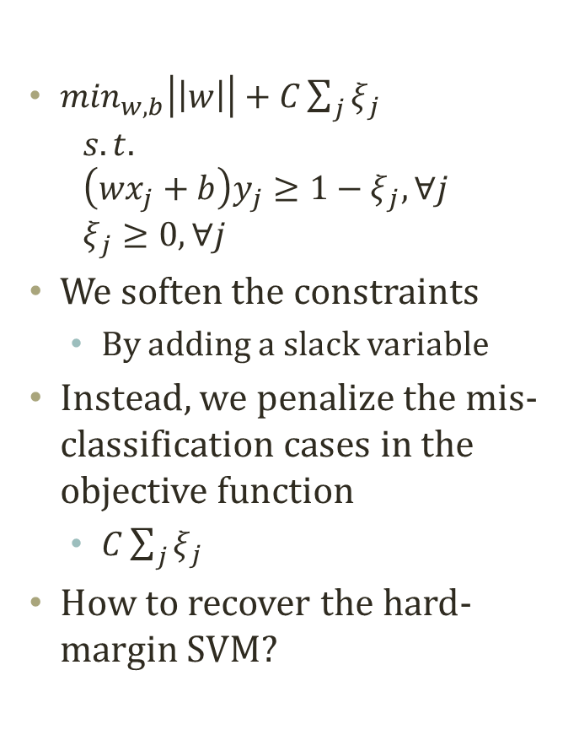











Soft-Margin SVM
$$ξ_{j}=0$$
$$ξ_{j}=0$$
$\min_{w,b}\left|\left|w\right|\right|+C\sum_{j}{ξ_{j}}$ $s.t.$ $\left(wx_{j}+b\right)y_{j}≥1−ξ_{j},∀j$ $ξ_{j}≥0,∀j$
We soften the constraints
By adding a slack variable
Instead, we penalize the mis-classification cases in the objective function
$C\sum_{j}{ξ_{j}}$
How to recover the hard-margin SVM?
$$ξ_{j}=0$$
$$ξ_{j}=0$$
$$ξ_{j}>1$$
${1>ξ}_{j}>$0
$$ξ_{j}=0$$
$$ξ_{j}=0$$
$$ξ_{j}=0$$
$$ξ_{j}=0$$
$$ξ_{j}>1$$
$$ξ_{j}=0$$
$$ξ_{j}=0$$
Hinge Loss
$$ξ_{j}={(1−\left(wx_{j}+b\right)y_{j}\text{)}}_{+}$$
-1
0
1
$$\left(wx_{j}+b\right)y_{j}$$

Slide 15
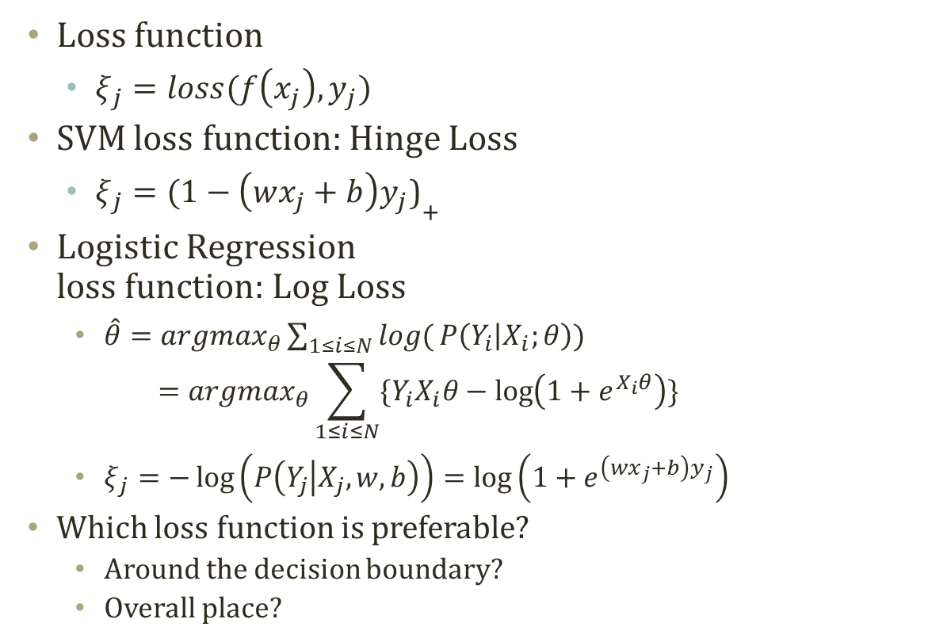
Comparison to Logistic Regression
Loss function
$ξ_{j}=loss(f\left(x_{j}\right),y_{j})$
SVM loss function: Hinge Loss
$ξ_{j}={(1−\left(wx_{j}+b\right)y_{j}\text{)}}_{+}$
Logistic Regression loss function: Log Loss
$\hat{θ}={argmax}_{θ}\sum_{1≤i≤N}{log(}P\left(Y_{i} | X_{i};θ\right))$ $={argmax}_{θ}\sum_{1≤i≤N}{\{Y_{i}X_{i}θ−\log\left(1+e^{X_{i}θ}\right)\}}$
$ξ_{j}=−\log\left(P\left(Y_{j} | X_{j},w,b\right)\right)=\log\left(1+e^{\left(wx_{j}+b\right)y_{j}}\right)$
Which loss function is preferable?
Around the decision boundary?
Overall place?

Slide 16
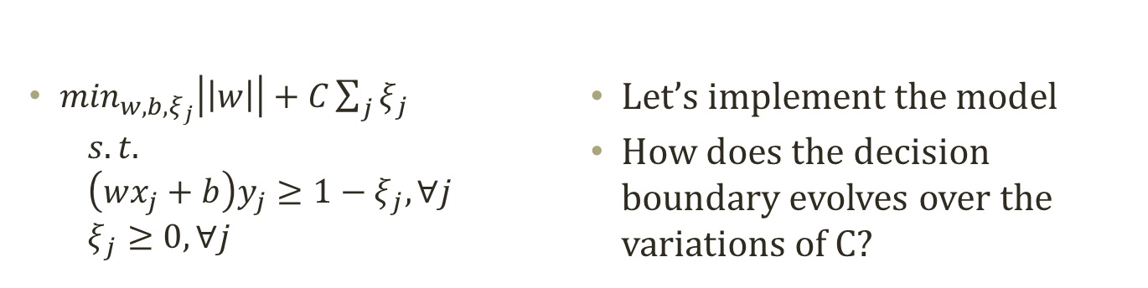
Strength of the Loss Function
$\min_{w,b,ξ_{j}}\left|\left|w\right|\right|+C\sum_{j}{ξ_{j}}$ $s.t.$ $\left(wx_{j}+b\right)y_{j}≥1−ξ_{j},∀j$ $ξ_{j}≥0,∀j$
Let’s implement the model
How does the decision boundary evolves over the variations of C?

Slide 17
Kernel trick

Slide 18
Enough of Studying SVM?
Non-linear decision boundary
You can train the SVM when you even have “error” cases
Use a soft-margin to handle such errors
However, this does not change the complexity of the decision boundary
In the real world, there are situations which require complex decision boundary…
Option 1
Make decision boundary more complex
Go to non-linear
Option 2
Admit there will be an “error”
Represent the error in our problem formulation.

Slide 19
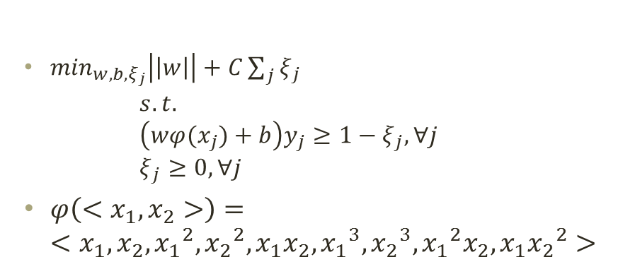
Feature Mapping to Expand Dim.
$\min_{w,b,ξ_{j}}\left|\left|w\right|\right|+C\sum_{j}{ξ_{j}}$ $s.t.$ $\left(wφ(x_{j})+b\right)y_{j}≥1−ξ_{j},∀j$ $ξ_{j}≥0,∀j$
$φ\left(<x_{1},x_{2}>\right)=$ $<x_{1},x_{2}, {x_{1}}^{2},{x_{2}}^{2},x_{1}x_{2},{x_{1}}^{3},{x_{2}}^{3},{x_{1}}^{2}x_{2},x_{1}{x_{2}}^{2}>$
Linearly Separable Dataset
Any problem???
# of Params, Representation, Computation….
Linear Decision Boundary on

Slide 20
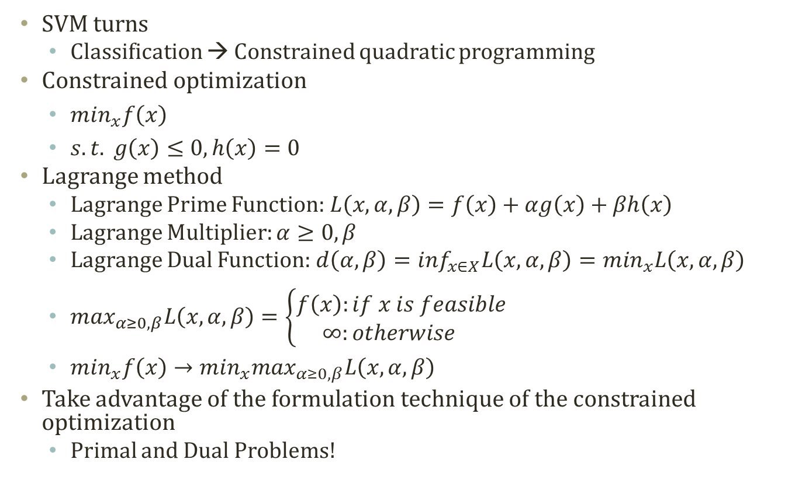
Rethinking the Formulation
SVM turns
Classification → Constrained quadratic programming
Constrained optimization
$\min_{x}f\left(x\right)$
$s.t. g\left(x\right)≤0,h\left(x\right)=0$
Lagrange method
Lagrange Prime Function: $L\left(x,α,β\right)=f\left(x\right)+αg\left(x\right)+βh\left(x\right)$
Lagrange Multiplier: $α≥0,β$
Lagrange Dual Function: $d\left(α,β\right)=\inf_{x∈X}L\left(x,α,β\right)=\min_{x}L\left(x,α,β\right)$
$\max_{α≥0,β}L\left(x,α,β\right)=\left\{\begin{aligned}f\left(x\right):if x is feasible \\ ∞:otherwise \end{aligned}\right.$
$\min_{x}f\left(x\right)→\min_{x}\max_{α≥0,β}L\left(x,α,β\right)$
Take advantage of the formulation technique of the constrained optimization
Primal and Dual Problems!
inf: infimum “Greatest Lower Bound”
inf{1,2,3} = 1

Slide 21
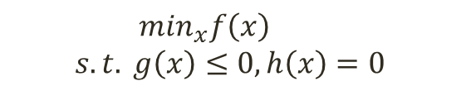
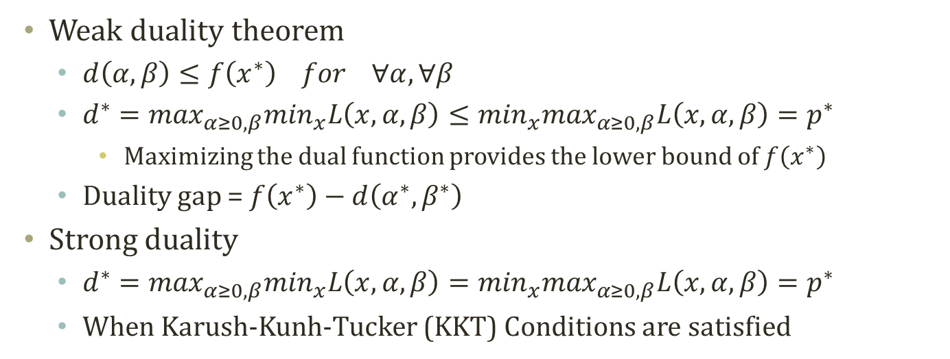



Primal and Dual Problem
Primal Problem
Lagrange Dual Problem
$$\min_{x}f\left(x\right)$$
$$s.t. g\left(x\right)≤0,h\left(x\right)=0$$
$$\max_{α>0,β}d\left(α,β\right)$$
$$s.t.α>0$$
$$\min_{x}\max_{α≥0,β}L\left(x,α,β\right)$$
$$\max_{α≥0,β}\min_{x}L\left(x,α,β\right)$$
Weak duality theorem
$d\left(α,β\right)≤f\left(x^{∗}\right) for ∀α,∀β$
$d^{∗}=\max_{α≥0,β}\min_{x}L\left(x,α,β\right)≤\min_{x}\max_{α≥0,β}L\left(x,α,β\right)=p^{∗}$
Maximizing the dual function provides the lower bound of $f\left(x^{∗}\right)$
Duality gap = $f\left(x^{∗}\right)−d\left(α^{∗},β^{∗}\right)$
Strong duality
$d^{∗}=\max_{α≥0,β}\min_{x}L\left(x,α,β\right)=\min_{x}\max_{α≥0,β}L\left(x,α,β\right)=p^{∗}$
When Karush-Kunh-Tucker (KKT) Conditions are satisfied

Slide 22

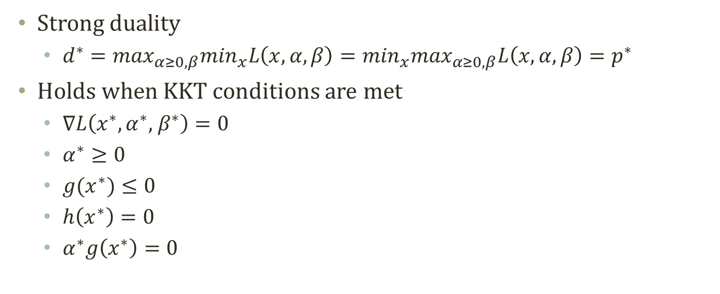

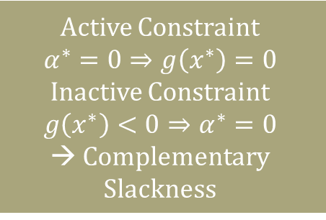
KKT Condition and Strong Duality
Strong duality
$d^{∗}=\max_{α≥0,β}\min_{x}L\left(x,α,β\right)=\min_{x}\max_{α≥0,β}L\left(x,α,β\right)=p^{∗}$
Holds when KKT conditions are met
$∇L\left(x^{∗},α^{∗}\text{, }β^{∗}\right)=0$
$α^{∗}≥0$
$g(x^{∗})≤0$
$h\left(x^{∗}\right)=0$
$α^{∗}g\left(x^{∗}\right)=0$
Primal Problem
Active Constraint
$$α^{∗}=0⇒g\left(x^{∗}\right)=0$$
Inactive Constraint
$$g\left(x^{∗}\right)<0⇒α^{∗}=0$$
→ Complementary Slackness
$$\min_{x}f\left(x\right)$$
$$s.t. g\left(x\right)≤0,$$
$$h\left(x\right)=0$$
Always
Strong Duality
$$d^{∗}=p^{∗}$$
KKT Condition
For convex optimization
Primal and dual problems are equivalent for the constrained convex optimization

Slide 23


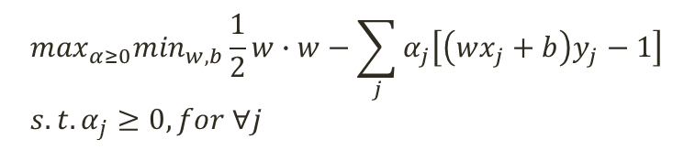
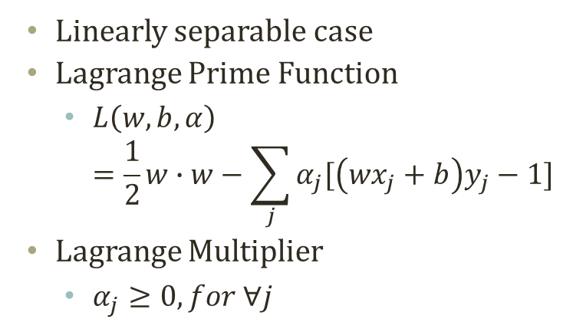
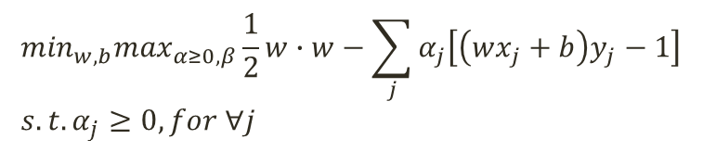




Dual Problem of SVM
Primal Problem
$$\min_{x}f\left(x\right)$$
$$s.t. g\left(x\right)≤0,$$
$$h\left(x\right)=0$$
Lagrange Prime Function
Primal Problem of Linearly Separable SVM
$$L\left(x,α,β\right)=f\left(x\right)+αg\left(x\right)+βh\left(x\right)$$
$$\min_{w,b}|\left|w\right|| \\ s.t. \left(wx_{j}+b\right)y_{j}≥1,∀j$$
$$\min_{w,b}\max_{α≥0,β}\frac{1}{2}w∙w−\sum_{j}{α_{j}\left[\left(wx_{j}+b\right)y_{j}−1\right]} \\ s.t.α_{j}≥0, for ∀j$$
Dual Problem of Linearly Separable SVM
$$\max_{α≥0}\min_{w,b}\frac{1}{2}w∙w−\sum_{j}{α_{j}\left[\left(wx_{j}+b\right)y_{j}−1\right]} \\ s.t.α_{j}≥0, for ∀j$$
Linearly separable case
Lagrange Prime Function
$L\left(w,b,α\right)$ $=\frac{1}{2}w∙w−\sum_{j}{α_{j}[\left(wx_{j}+b\right)y_{j}−1]}$
Lagrange Multiplier
$α_{j}≥0, for ∀j$
KKT Condition to Eliminate the Duality Gap
$\frac{∂L(w, b, α)}{∂w}$ = 0 , $\frac{∂L(w, b, α)}{∂b}$ = 0
$$α_{i}≥0, ∀i$$
$$α_{i}\left(\left(wx_{j}+b\right)y_{j}−1\right)=0,∀i$$

Slide 24



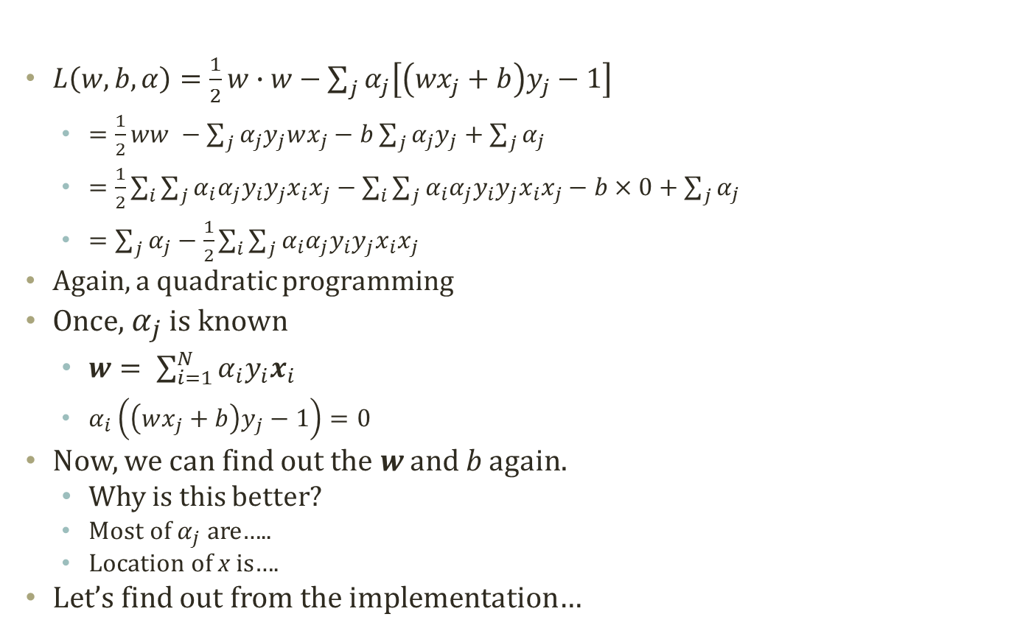



Dual Representation of SVM
$L\left(w,b,α\right)=\frac{1}{2}w∙w−\sum_{j}{α_{j}\left[\left(wx_{j}+b\right)y_{j}−1\right]}$
$=\frac{1}{2}ww −\sum_{j}{α_{j}y_{j}wx_{j}}−b\sum_{j}{α_{j}y_{j}}+\sum_{j}{α_{j}}$
$=\frac{1}{2}\sum_{i}{\sum_{j}{α_{i}α_{j}y_{i}y_{j}x_{i}x_{j}}}−\sum_{i}{\sum_{j}{α_{i}α_{j}y_{i}y_{j}x_{i}x_{j}}}−b×0+\sum_{j}{α_{j}}$
$=\sum_{j}{α_{j}}−\frac{1}{2}\sum_{i}{\sum_{j}{α_{i}α_{j}y_{i}y_{j}x_{i}x_{j}}}$
Again, a quadratic programming
Once, $α_{j}$ is known
$w= \sum_{i=1}^{N}{α_{i}y_{i}x_{i}}$
$α_{i}\left(\left(wx_{j}+b\right)y_{j}−1\right)=0$
Now, we can find out the w and b again.
Why is this better?
Most of $α_{j}$ are…..
Location of x is….
Let’s find out from the implementation…
Dual Problem of Linearly Separable SVM
$$\max_{α≥0}\min_{w,b}\frac{1}{2}w∙w−\sum_{j}{α_{j}\left[\left(wx_{j}+b\right)y_{j}−1\right]} \\ s.t.α_{j}≥0, for ∀j$$
KKT Condition to Eliminate the Duality Gap
$\frac{∂L(w, b, α)}{∂w}$ = 0 , $\frac{∂L(w, b, α)}{∂b}$ = 0
$$α_{i}≥0, ∀i$$
$$α_{i}\left(\left(wx_{j}+b\right)y_{j}−1\right)=0,∀i$$
$$w= \sum_{i=1}^{N}{α_{i}y_{i}x_{i}}$$
$$\sum_{i=1}^{N}{α_{i}y_{i}}=0$$

Slide 25


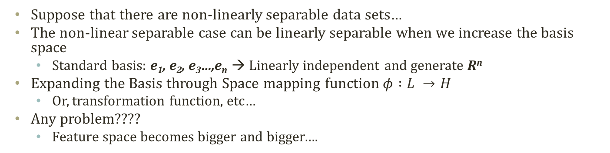





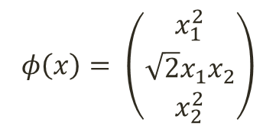




Mapping Functions
Suppose that there are non-linearly separable data sets…
The non-linear separable case can be linearly separable when we increase the basis space
Standard basis: e₁, e₂, e₃…,e_{n} → Linearly independent and generate R^{n}
Expanding the Basis through Space mapping function $φ :L →H$
Or, transformation function, etc…
Any problem????
Feature space becomes bigger and bigger….
$$x_{2}$$
$$x_{2}^{2}$$
$$φ\left(x\right)= \left(\begin{matrix}x_{1}^{2} \\ \sqrt{2}x_{1}x_{2} \\ x_{2}^{2}\end{matrix}\right)$$
$$\hat{c}=(0,0,1)^{T}$$
(1,1)
(0,1)
d
$$\hat{b}=(1,0,0)^{T}$$
c
$$\hat{a}=(0,0,0)^{T}$$
$$x_{1}^{2}$$
(1,0)
(0,0)
a
b
$$x_{1}$$
$$\hat{d}=(1,\sqrt{2},1)^{T}$$
$$\left(a\right) Original space, L$$
$$\sqrt{2}x_{1}x_{2}$$
$$\left(b\right) Mapping space, H$$

Slide 26
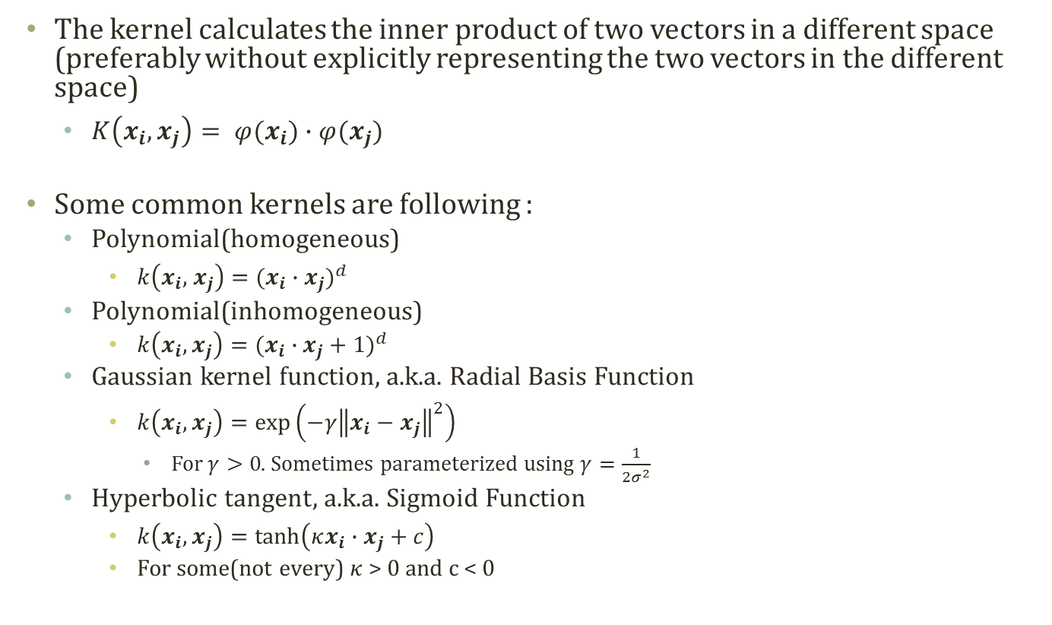
Kernel Function
The kernel calculates the inner product of two vectors in a different space (preferably without explicitly representing the two vectors in the different space)
$K\left(x_{i}, x_{j}\right)= φ(x_{i})∙φ(x_{j})$
Some common kernels are following :
Polynomial(homogeneous)
$k\left(x_{i}, { x}_{j}\right)=(x_{i}∙x_{j})^{d}$
Polynomial(inhomogeneous)
$k\left(x_{i}, x_{j}\right)=(x_{i}∙x_{j}+1)^{d}$
Gaussian kernel function, a.k.a. Radial Basis Function
$k\left(x_{i}, x_{j}\right)=\exp\left(−γ{\left\|x_{i}−x_{j}\right\|}^{2}\right)$
For $γ>0$. Sometimes parameterized using $γ=\frac{1}{2σ^{2}}$
Hyperbolic tangent, a.k.a. Sigmoid Function
$k\left(x_{i}, x_{j}\right)=\tanh\left(κx_{i}∙x_{j}+c\right)$
For some(not every) $κ$ > 0 and c < 0

Slide 27
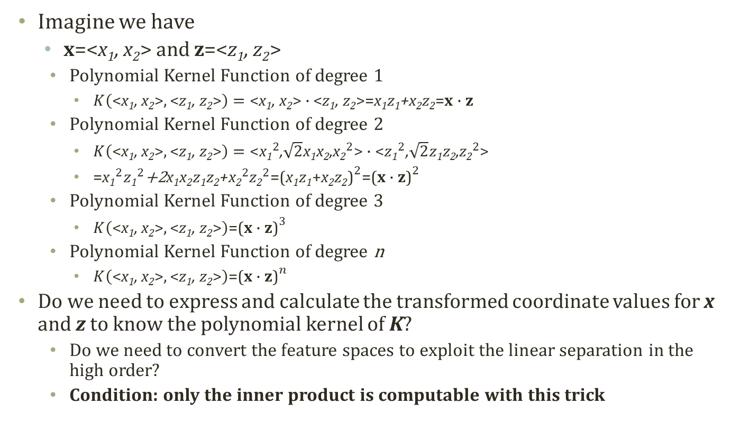
Polynomial Kernel Function
Imagine we have
x=<x₁, x₂> and z=<z₁, z₂>
Polynomial Kernel Function of degree 1
$K\left(\text{<}\text{x}\text{1}\text{, }\text{x}\text{2}\text{>},\text{<}\text{z}\text{1}\text{, }\text{z}\text{2}\text{>}\right)=\text{<}\text{x}\text{1}\text{, }\text{x}\text{2}\text{>}∙\text{<}\text{z}\text{1}\text{, }\text{z}\text{2}\text{>}\text{=}\text{x}\text{1}\text{z}\text{1}\text{+}\text{x}\text{2}\text{z}\text{2}\text{=}\text{x}∙\text{z}$
Polynomial Kernel Function of degree 2
$K\left(\text{<}\text{x}\text{1}\text{, }\text{x}\text{2}\text{>},\text{<}\text{z}\text{1}\text{, }\text{z}\text{2}\text{>}\right)=\text{<}{\text{x}\text{1}}^{2}\text{,}\sqrt{2}\text{x}\text{1}\text{x}\text{2}\text{,}{\text{x}\text{2}}^{2}\text{>}∙\text{<}{z\text{1}}^{2}\text{,}\sqrt{2}z\text{1}\text{z}\text{2}\text{,}{\text{z}\text{2}}^{2}\text{>}$
$\text{=}{\text{x}\text{1}}^{2}{z\text{1}}^{2}\text{+2}\text{x}\text{1}\text{x}\text{2}z\text{1}\text{z}\text{2}\text{+}{\text{x}\text{2}}^{2}{\text{z}\text{2}}^{2}\text{=}{\text{(}\text{x}\text{1}\text{z}\text{1}\text{+}\text{x}\text{2}\text{z}\text{2}\text{)}}^{2}\text{=}{\text{(}\text{x}∙\text{z}\text{)}}^{2}$
Polynomial Kernel Function of degree 3
$K\left(\text{<}\text{x}\text{1}\text{, }\text{x}\text{2}\text{>},\text{<}\text{z}\text{1}\text{, }\text{z}\text{2}\text{>}\right)\text{=}{\text{(}\text{x}∙\text{z}\text{)}}^{3}$
Polynomial Kernel Function of degree n
$K\left(\text{<}\text{x}\text{1}\text{, }\text{x}\text{2}\text{>},\text{<}\text{z}\text{1}\text{, }\text{z}\text{2}\text{>}\right)\text{=}{\text{(}\text{x}∙\text{z}\text{)}}^{n}$
Do we need to express and calculate the transformed coordinate values for x and z to know the polynomial kernel of K?
Do we need to convert the feature spaces to exploit the linear separation in the high order?
Condition: only the inner product is computable with this trick

Slide 28
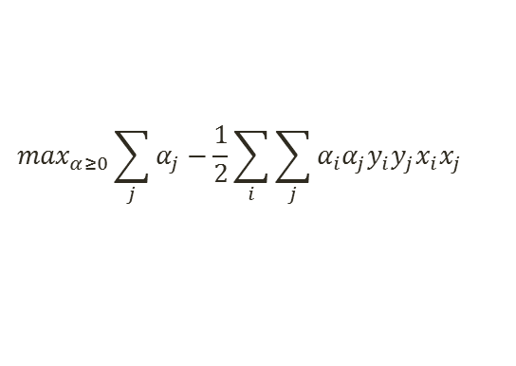
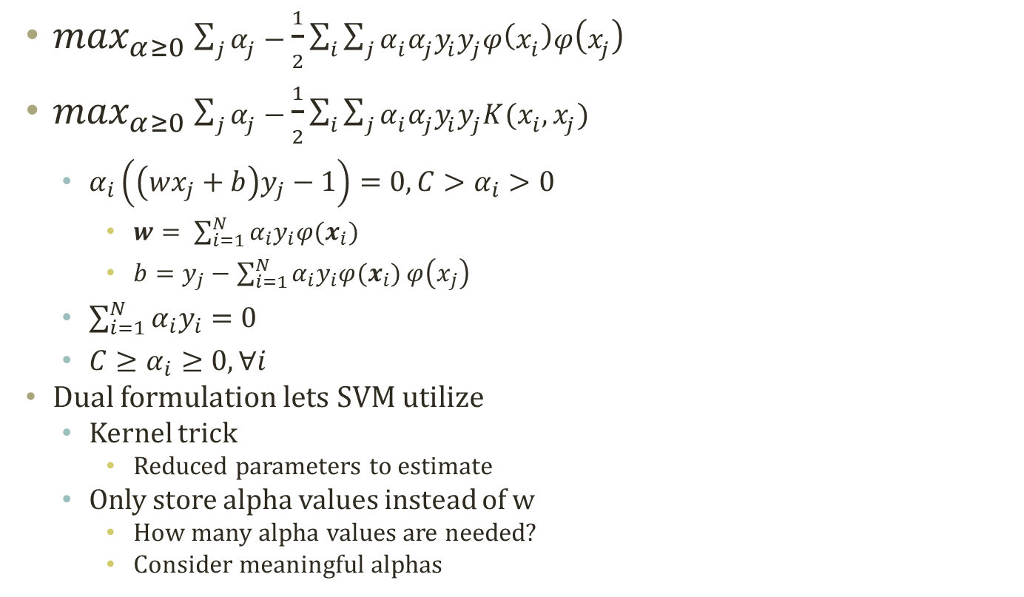



Dual SVM with Kernel Trick
$\max_{α≥0}\sum_{j}{α_{j}}−\frac{1}{2}\sum_{i}{\sum_{j}{α_{i}α_{j}y_{i}y_{j}φ\left(x_{i}\right)φ\left(x_{j}\right)}}$
$\max_{α≥0}\sum_{j}{α_{j}}−\frac{1}{2}\sum_{i}{\sum_{j}{α_{i}α_{j}y_{i}y_{j}K(x_{i},x_{j})}}$
$α_{i}\left(\left(wx_{j}+b\right)y_{j}−1\right)=0,C>α_{i}>0$
$w= \sum_{i=1}^{N}{α_{i}y_{i}φ(x_{i})}$
$b=y_{j}−\sum_{i=1}^{N}{α_{i}y_{i}φ(x_{i})}φ\left(x_{j}\right)$
$\sum_{i=1}^{N}{α_{i}y_{i}}=0$
$C≥α_{i}≥0, ∀i$
Dual formulation lets SVM utilize
Kernel trick
Reduced parameters to estimate
Only store alpha values instead of w
How many alpha values are needed?
Consider meaningful alphas
Dual Problem of Linearly Separable SVM
$$\max_{α≥0}\sum_{j}{α_{j}}−\frac{1}{2}\sum_{i}{\sum_{j}{α_{i}α_{j}y_{i}y_{j}x_{i}x_{j}}}$$
$$C≥α_{i}≥0, ∀i$$
$$\sum_{i=1}^{N}{α_{i}y_{i}}=0$$
$$α_{i}\left(\left(wx_{j}+b\right)y_{j}−1\right)=0,C>α_{i}>0$$

Slide 29
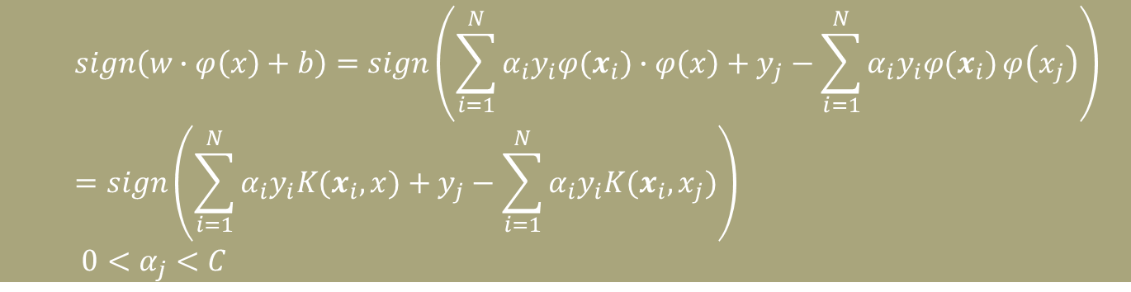

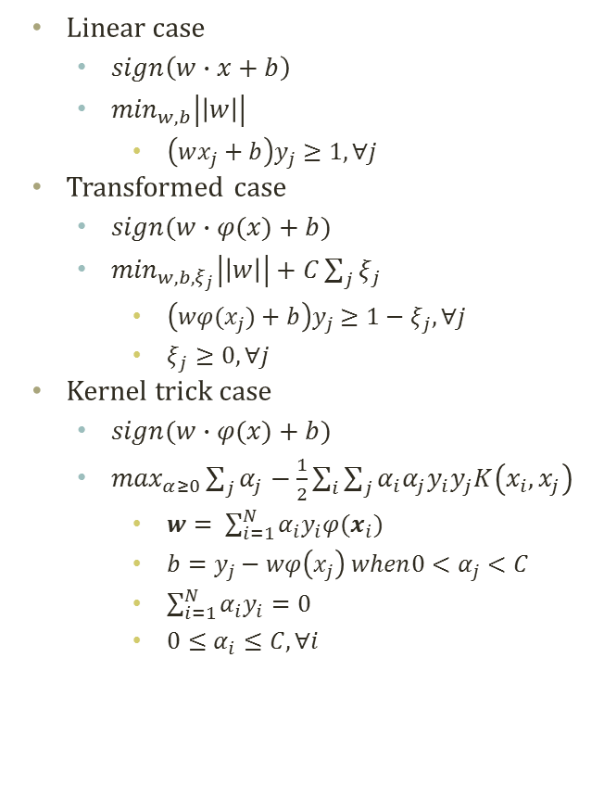



Classification with SVM Kernel Trick
Linear case
$sign\left(w∙x+b\right)$
$\min_{w,b}\left|\left|w\right|\right|$
$\left(wx_{j}+b\right)y_{j}≥1,∀j$
Transformed case
$sign(w∙φ(x)+b)$
$\min_{w,b,ξ_{j}}\left|\left|w\right|\right|+C\sum_{j}{ξ_{j}}$
$\left(wφ(x_{j})+b\right)y_{j}≥1−ξ_{j},∀j$
$ξ_{j}≥0,∀j$
Kernel trick case
$sign(w∙φ(x)+b)$
$\max_{α≥0}\sum_{j}{α_{j}}−\frac{1}{2}\sum_{i}{\sum_{j}{α_{i}α_{j}y_{i}y_{j}K\left(x_{i},x_{j}\right)}}$
$w= \sum_{i=1}^{N}{α_{i}y_{i}φ(x_{i})}$
$b=y_{j}−wφ\left(x_{j}\right) when{0<α}_{j}<C$
$\sum_{i=1}^{N}{α_{i}y_{i}}=0$
${0≤α}_{i}≤C, ∀i$
$$f\left(x\right)=w∙x+b=−a$$
$$r=\frac{f(x)}{|\left|w\right||}$$
$f\left(x\right)=w∙x+b$=0
$$f\left(x\right)=w∙x+b=a$$
$$sign\left(w∙φ\left(x\right)+b\right)=sign\left(\sum_{i=1}^{N}{α_{i}y_{i}φ(x_{i})}∙φ\left(x\right)+y_{j}−\sum_{i=1}^{N}{α_{i}y_{i}φ(x_{i})}φ\left(x_{j}\right)\right)=sign\left(\sum_{i=1}^{N}{α_{i}y_{i}K(x_{i},x)}+y_{j}−\sum_{i=1}^{N}{α_{i}y_{i}K(x_{i},x_{j})}\right)$$ ${0<α}_{j}<C$

Slide 30

SVM with Various Kernels
SVM is very adaptable to the non-linearly separable cases with the kernel trick
Easy expand to the high dimension features (for free!)
Polynomial Kernel with Degree 4
RBF Kernel with $γ$=4

Slide 31
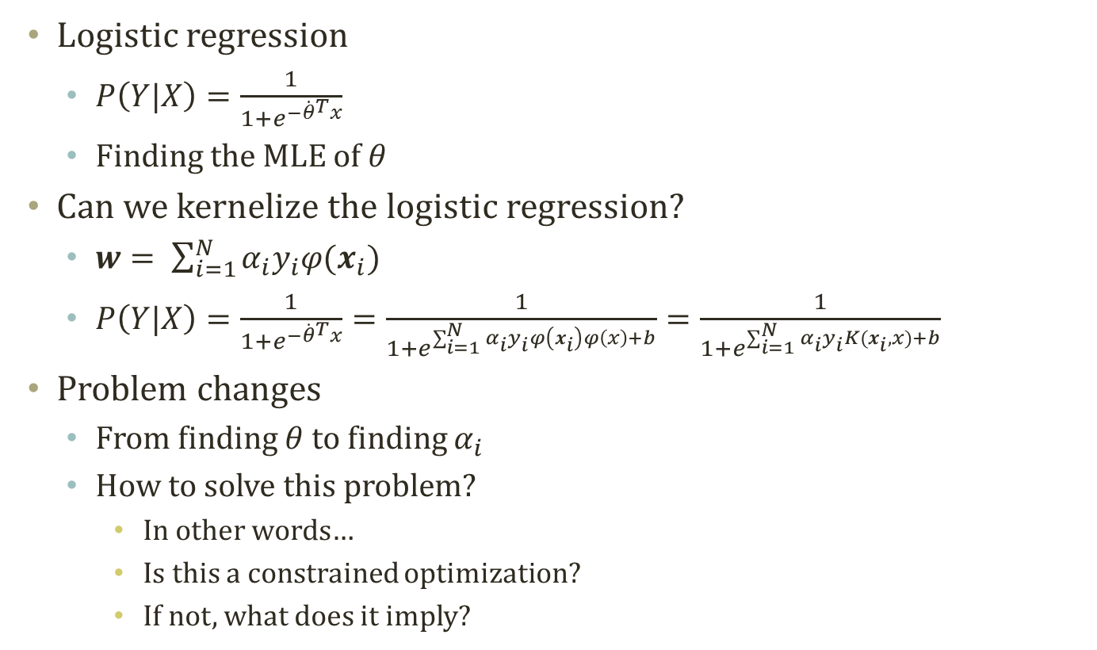
Logistic Regression with Kernel
Logistic regression
$P\left(Y|X\right)=\frac{1}{1+e^{−{\dot{θ}}^{T}x}}$
Finding the MLE of $θ$
Can we kernelize the logistic regression?
$w= \sum_{i=1}^{N}{α_{i}y_{i}φ(x_{i})}$
$P\left(Y|X\right)=\frac{1}{1+e^{−{\dot{θ}}^{T}x}}=\frac{1}{1+e^{\sum_{i=1}^{N}{α_{i}y_{i}φ\left(x_{i}\right)}φ\left(x\right)+b}}=\frac{1}{1+e^{\sum_{i=1}^{N}{α_{i}y_{i}K(x_{i},x)}+b}}$
Problem changes
From finding $θ$ to finding $α_{i}$
How to solve this problem?
In other words…
Is this a constrained optimization?
If not, what does it imply?

Slide 32
Acknowledgement
This slideset is greatly influenced
By Prof. Carlos Guestrin at CMU
By Prof. Eric Xing at CMU

Slide 33
Further Readings
Bishop Chapter 7 → 6

